Slide 1
The Nucleus’ Physical Role in Collective Cell Migration
Presented By: Brady Hine
Notes:
Hi, I’m Brady and the specific problem I’ll be trying to address this year in MECH 498 is how mechanical properties of the cell nucleus affect collective cell migration.

Slide 2
Introduction
Significance
Problem
Cell repopulation
Wound healing
Developmental tissues
Collective migration
Nucleus limiting factor
Scratch wound assay
Notes:
Collective cell migration is a necessary function for many biological processes to work effectively including, but not limited to, repopulation of cells after tissue engineering, wound healing mechanisms, or formation of developmental tissues. The nucleus’ importance in this is that it serves as a limiting factor for migration due to it often being the largest and stiffest organelle in the cell. To investigate the effects of these impacts on collective cell migration a scratch wound assay model is being used where a layer of cells is cultured, a scratch is applied, and time lapse imaging of the healing process is then used to quantify migration parameters.

Slide 3
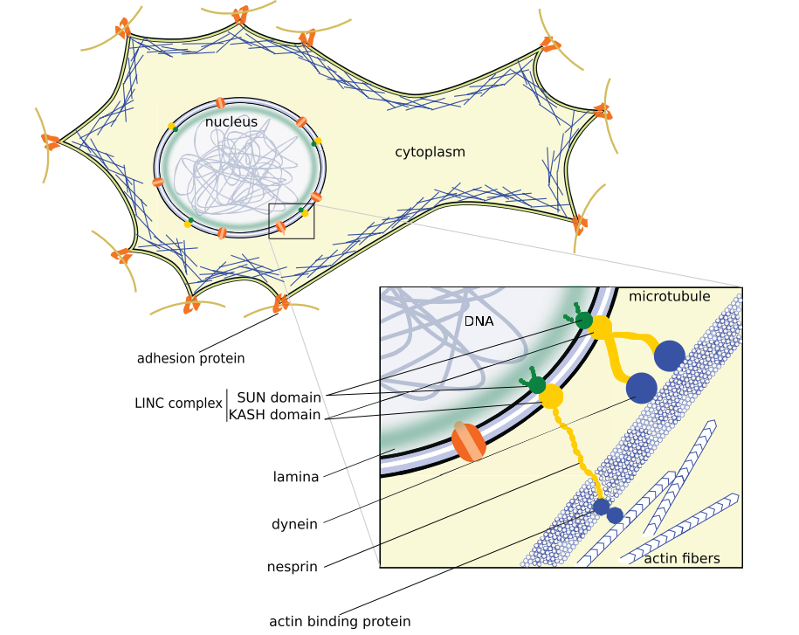
Background
Cell movement
Actin network
LINC complex
Migration
Single vs. collective
Cell-cell interactions
A. Fruleux and R. J. Hawkins, “Physical role for the nucleus in cell migration,” J. Phys. Condens. Matter, vol. 28, no. 36, p. 363002, Jul. 2016, doi: 10.1088/0953-8984/28/36/363002.
Notes:
Getting into some background information, the main way that cells move is by forces generated from the actin network and myosin motor proteins. This movement is generally in response to chemical or mechanical signals outside the cell detected by focal adhesions connected to the cytoskeleton with the extracellular matrix. The cytoskeleton is also attached to the nucleus by the LINC complex shown here composed of transmembrane proteins connecting nuclear lamina to actin fibers and microtubules. The green lamina seen here is composed of intermediate filaments, known as lamin, and serve to provide the nucleus its rigidity. Something also important to understand is that the process of migration is different between single cells and a group, sheet, or chain of cells moving together known as collective migration. This difference comes from additional forces experienced from cell-cell adhesions allowing for chemical and mechanical communication between the cells as they move together.

Slide 4
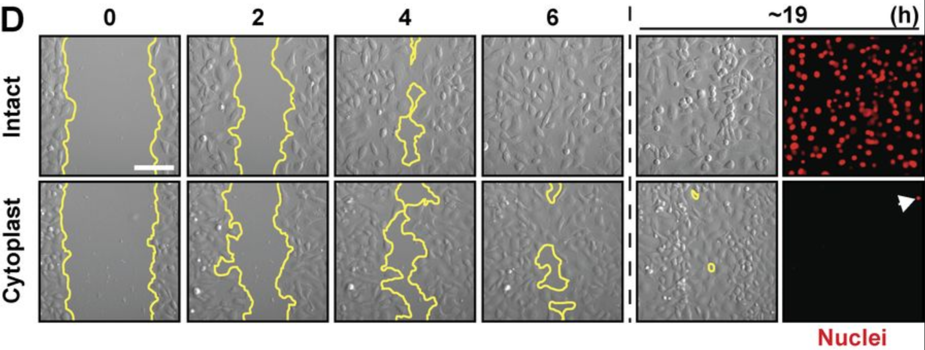
Previous Approaches
Enucleated mammal cells
Only planar migration
Decreased migration efficiency
D. M. Graham et al., “Enucleated cells reveal differential roles of the nucleus in cell migration, polarity, and mechanotransduction,” J. Cell Biol., vol. 217, no. 3, pp. 895–914, Mar. 2018, doi: 10.1083/JCB.201706097.
Notes:
Previous work that has looked into the nucleus’ physical role in collective cell migration started by using enucleated mammal cells or cytoplasts and compared their migratory abilities to those of intact cells. It was found that the cytoplasts were only able to migrate in a planar manner and no longer in a 3D space. The planar migration had also decreased in efficiency for the cytoplasts as seen by results from a scratch wound assay here with intact cells closing the wound fully at 6 hours and the cytoplasts still not fully closing the wound after 19 hours. These results showed that the nucleus is critical for proper cell mechanical response.

Slide 5
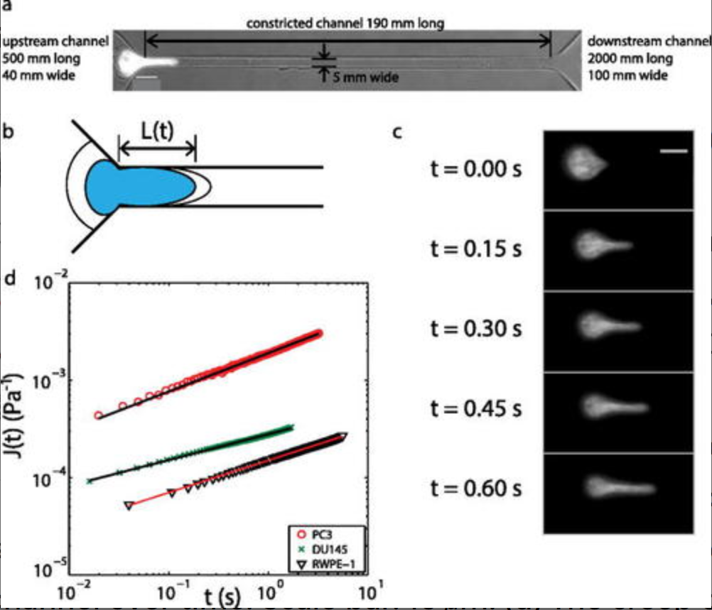
Previous Approaches
Metastatic prostate cancer
Cancer vs. normal cell nucleus
Varied aggressiveness
Z. S. Khan, J. M. Santos, and F. Hussain, “Aggressive prostate cancer cell nuclei have reduced stiffness,” Biomicrofluidics, vol. 12, no. 1, p. 014102, Jan. 2018, doi: 10.1063/1.5019728.
Notes:
Another approach involved investigating nuclear differences in varying levels of metastatic prostate cancer. The team conducted a nuclear creep experiment using a microfluidic channel with a narrow constriction and observed the time required for these different cells to enter the constricted channel. Their results showed that more highly metastatic cancer cells were able to travel faster through confined environments than those less metastatic. The imaging from these tests then allowed the researchers to measure the nuclear stiffnesses of the cells and found a trend that the more aggressive the cancer cell was, the softer the nucleus was.

Slide 6
Specific Aims
Aim #1
Establish a scratch wound assay of cell migration using NIH-3T3 cells
Migration quantification and validation
Y27 (myosin contraction inhibition) and/or cyto-D (actin inhibition)
Aim #2
Observe how changes to nuclear mechanics affect migration parameters
Modify stiffness and chromatin remodeling
Trichostatin A (softening by HDAC inhibition) and GSK126 (stopping chromatin remodeling)
Notes:
That leads me to the specific aims for this project. The first of which being to establish the scratch wound assay that will be used to conduct these experiments. This aim will also include determining methods for quantifying migration as well as validating the setup by using some migration inhibitors. The second aim for the project will involve observing how changes to nuclear mechanical factors impacts the quantified migration parameters. Modifying the nucleus will be done by applying some drugs that will affect chromatin remodeling and nuclear stiffness.

Slide 7
Specific Aims
Aim #3
Perform live imaging of the cytoskeleton and nucleus at high resolution to quantify a strain map in the cell monolayer.
NucBlue (nucleus) and Lifeact (actin)
Future work
Investigate interactions between nuclear mechanics with substrate mechanics and cell crowding
Notes:
The last specific aim for this project will involve using live staining and imaging of the nucleus and actin cytoskeleton during the scratch wound assay. This data will then be used to develop a strain map at the cell monolayer level providing detailed mechanical insight into the migration process. If these aims are successfully met, it’d help lay groundwork for looking into interactions of nuclear mechanics with cell crowding effects and substrate mechanics.

Slide 8
Preliminary Work
Cell culture and scratch application
Confluence timing (1-3 days)
Scratch methodology
Assay imaging
Imaging timeframe (~12 hrs)
Cell maintenance
Notes:
The bulk of the preliminary work done to this point has been spent establishing the scratch wound assay. This began with determining a proper time for culturing the cells in an 8-well plate until they were confluent being 1-3 days. The image shown here was one of our initial attempts at performing the scratch which was a bit crude along the edges and had a bit of debris present which was not optimal. So next it was important to establish a repeatable method for making scratches on the monolayer with as clean edges as possible which was done using a pipette tip and straight edge as a guide. The impact of this can be seen in this fixed stained image comparing the scratch edges of the two. It has been determined that an optimal timeframe for migration imaging after scratch application is around 12 hours. Identifying the timeframe was time consuming as medium must be added to the wells throughout the imaging process to avoid having the cells dry out limiting the feasible imaging duration.

Slide 9
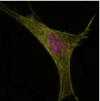
Preliminary Work
Cell staining
Fixed nucleus (DAPI) and actin (phalloidin)
Live nucleus (NucBlue) and actin (Lifeact)
Live stain timing
Notes:
Work has also been done establishing cell staining methods for actin and the nucleus in both live and fixed cells. Staining of fixed cells on the left allowed us to observe cell morphology and density in the wound more clearly at a given time point. While live staining shown on the right is used to track cells as they migrate and will be used for strain map development. Different live and fixed stains are required due to live stains needing to small enough to fit through pores in live cells where fixed cells can be permeabilized. With live staining, we have seen that long exposure may cause adverse effects as well as the stains used being photosensitive requires a specific time window to apply the live stains.

Slide 10
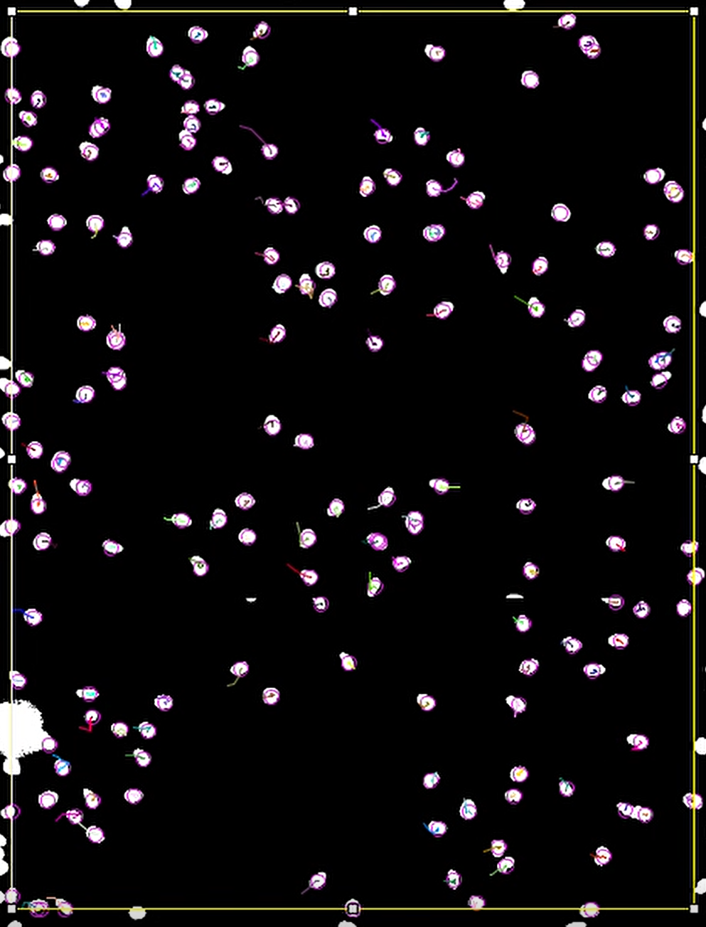
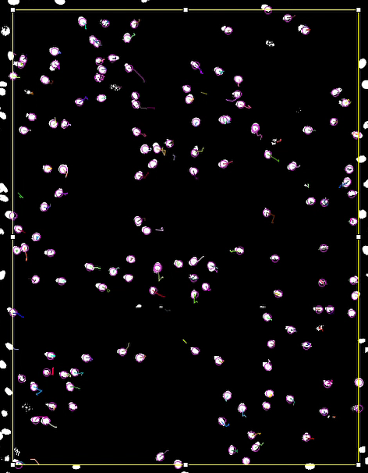
Preliminary Work
Image Processing
Automated cell tracking
Path calculations
Notes:
The most current work is focusing on image processing specifically using automated cell tracking. The image here shows the tracking method with cell nuclei in white with spot detection shown as purple rings and migration paths automatically traced. This video gives further clarification of the process. This automated tracking allows us to quantify parameters like speed and persistence of the individual migrating cells.

Slide 11
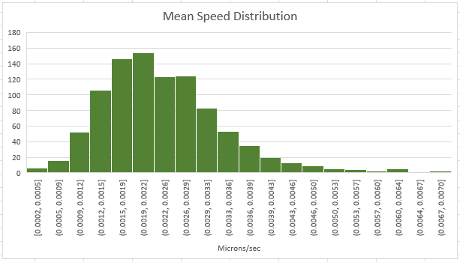
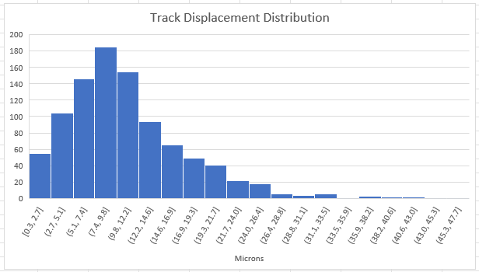
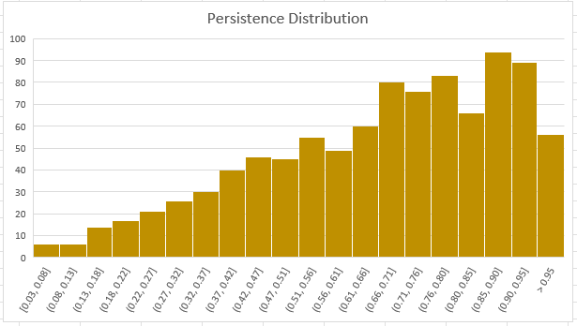
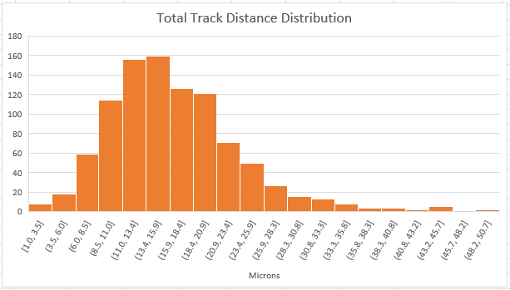
Preliminary Data
Track Displacement (micron) | Total Track Distance (micron) | Mean Speed (micron/sec) | Persistence
11.004 (6.699) | 16.403 (7.023) | 0.00238 (0.00099) | 0.661 (0.225)
Values are presented as: mean (standard deviation)
Notes:
This preliminary data was taken from the wound region of a single well in which 958 cells were tracked. The table values are given as a mean with a standard deviation in parentheses and a visualization of the distributions are provided above. Track displacement is shown on the left and total track distance on the right. Mean speed and persistence distributions are then shown here. You can see that the cells are mostly persistent in their movement.

Slide 12
Approach – Aim 1
Validation
Cyto-D (actin inhibition)
Y27 (actomyosin contraction inhibition)
Control parameters
Inside and outside wound
Notes:
For the approach, the remainder of the fall 2021 semester will be used to complete aim 1 with final tasks including validation and establishing control parameters. Validation will be completed by repeating the experiment and treating cells with one or two migration blockers such as cyto-D to inhibit actin or Y27 to inhibit actomyosin contraction. Base parameters may then be determined using the assay and image processing techniques that have been established.

Slide 13
Approach – Aim 2
Drug application
Trichostatin A (HDAC inhibition)
GSK126 (halt chromatin remodeling)
Parameter comparison
Notes:
For aim 2, observing how modified nuclear mechanical properties affects migration will begin in the spring 2022 semester. Trichostatin A and GSK126 will be applied to the cells to alter the nucleus via HDAC inhibition and halting chromatin remodeling respectively. These cells will then be used in the scratch wound assay and have their migration parameters compared to that of the control NIH-3T3 cells.

Slide 14
Approach – Aim 3
Live stained
Nucblue (nucleus)
Lifeact (actin)
Strain mapping
Notes:
Soon following completion of Aim 2, the scratch wound assay will be repeated for both control and modified NIH-3T3 cells. The live stains Nucblue and Lifeact will be used to visualize the nucleus and actin respectively during the healing process. This will allow for the development of a strain map at the cell monolayer level providing detailed mechanical insight into the cell migration process both in the wound and the surrounding areas. We will quantify strain in both the cytoskeleton and nucleus to gain such insight which our lab has the ability to do.

Slide 15
Potential Complications
Aim 2
Non-lethal drug dosage
Aim 3
Strain mapping resolution
Notes:
The techniques established for this project are robust however, a couple pitfalls may arise. First, for aim 2 the dosage of Trichostatin A and GSK126 may need to be optimized. While Dr. Ghosh’s lab has previously determined the non-lethal dose of these drugs for NIH-3T3 cells, the dosage may not work for a confluent monolayer in which case the experiment will be performed at a lower dosage. Then, for aim 3, the strain mapping will require high resolution imaging in which only a few cells at a time may be imaged making the experiment not high throughput. In that case, it may be necessary to sacrifice some resolution to get enough datapoints for executing the statistical analysis.

Slide 16
Proposed Timeline
Project GANTT Chart | December | January | February | March | April
1 – Aim 1 Validation
2 – Aim 1 Baseline
3 – Aim 2 Data Collection & Analysis
4 – Aim 3 Experiment Replication
5 – Aim 3 Strain Mapping
6 – E-days Preparation
Notes:
For the proposed timeline, aim 1 focuses on establishing a validated and well-defined test setup necessary for Aims 2 and 3 that should be completed during the remainder of the fall 2021 semester. Data collection for Aim 2 will begin at the start of the spring 2022 semester while analysis may carry to February. This analysis may be conducted while experiments are being replicated for Aim 3. Development of the strain map for Aim 3 will then be the final step before preparations for E-days may begin.

